Slide 1
Chapter 12: Using Space Exploration to learn about stars, nebulae, and galaxies outside our solar system

Slide 2
12.1 Explaining the Early Universe
Edwin Hubble
Discovered galaxies other than the milky way.
Galaxy:
A collection of stars, planets, gas, and dust that are held together by gravity.
Our sun and planets are in the Milky Way Galaxy.
He noticed that all the galaxies were moving away from each other.

Slide 3
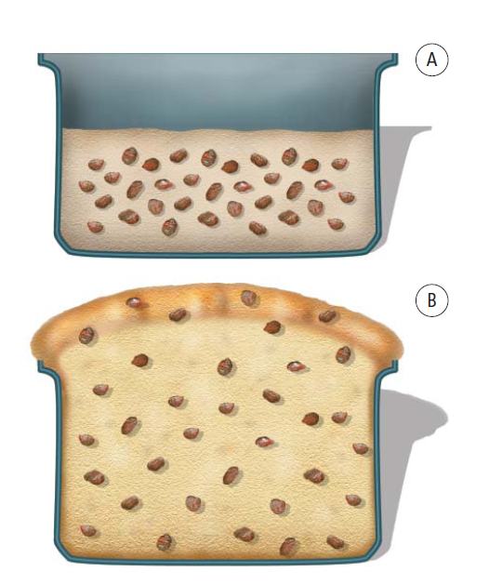
12.1 Explaining the Early Universe
Hubble, cont’d:
The conclusion he
reached was that the
universe is expanding in
all directions!

Slide 4
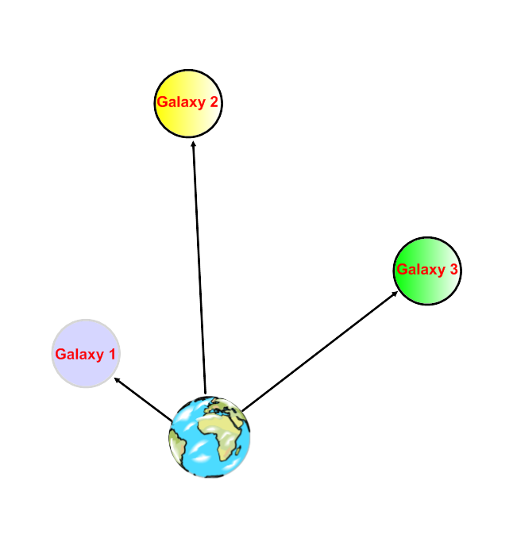
Red Shift Analysis
Used by Hubble to determine that
galaxies were moving away from
Earth at a speed that was
proportional to their distance.
Ex. Galaxy 3 is twice as far
from Earth than Galaxy 1 so it
moves twice as fast away from
Earth than does Galaxy 1.

Slide 5
Red Shift Analysis
Cosmological Red Shift:
Hubble noticed that the light from other galaxies showed spectral lines that were distinctly shifted towards the red end; this occurs because the lights’ wavelength becomes longer.
“Red-shifting indicates that the light is moving away from us; therefore, galaxies are moving away from us.

Slide 6
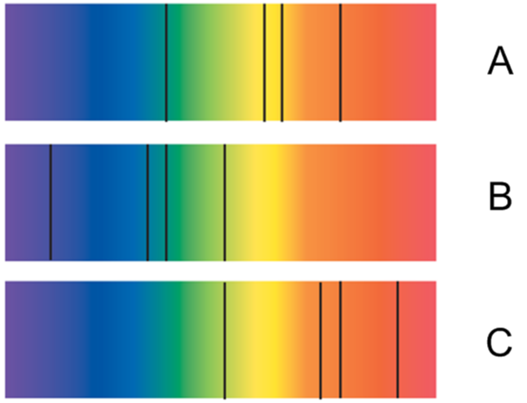
Red Shift Analysis
Cosmological Red Shift:
Color indicates the type
of gases an object is made
of. Location of the spectral
lines indicates if its
moving closer or further
away.
In the picture, B is Object A moving towards the Earth and C is Object A moving away from the Earth

Slide 7
Red Shift Analysis
Cosmological Red Shift:
https://www.youtube.com/watch?v=FhfnqboacV0
https://www.youtube.com/watch?v=mx2M_ZKXM_c

Slide 8
The Big Bang Theory
Because of Hubble’s theory, astronomers began to trace the path of the moving galaxies backwards in order to understand the early universe.
The Big Bang Theory
A theory that proposes that the universe formed approximately 13.7 billion years ago when an unimaginably tiny volume of space suddenly and rapidly expanded to immense size.

Slide 9
The Big Bang Theory, cont’d
First proposed by Georges Lemaitre in 1927
Most widely accepted theory to date.
The temperature during the Big Bang was over 1 billion degrees Celsius.
Since then, the universe has been cooling.
https://www.youtube.com/watch?v=uabNtlLfYyU

Slide 10
The Oscillating Theory
There is another theory that states that the expansion of the universe will stop and even reverse; all matter will meet again in a ‘Big Crunch.’
The Oscillating Theory states that the universe will go through a series of Big Bangs and Big Crunches in an ongoing cycle.

Slide 11
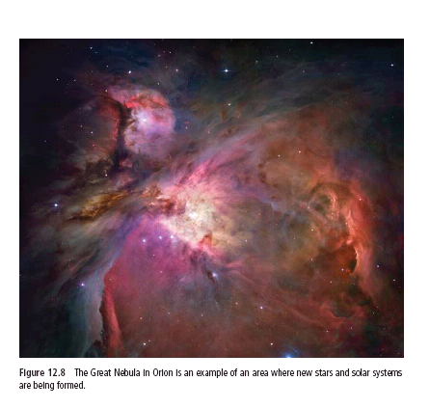
The Origin of Our Solar System
Nebulae:
Clouds of hydrogen gas and dust between stars and galaxies.
When the materials in
these clouds are pulled
together, stars form.

Slide 12
Nebulae, cont’d
Nebular hypothesis:
It is believed that our sun and planets formed when a large nebula condensed and collected together by gravity.
It is possible that a nearby exploding star created a shock wave which caused the nebula to start condensing.

Slide 13
The Origin of Our Solar System
Stellar Collision Theory
Our Sun and the planets were spun off from collisions between stars
https://www.youtube.com/watch?v=ZucjiKb6IRI
https://www.youtube.com/watch?v=ghEqtVrWhnY
https://www.youtube.com/watch?v=KXrMzS8e2BY

Slide 15
12.2 Galaxies and Stars
Spiral Galaxy
Has many long arms spiraling out from a centre point; looks like a pinwheel
Central bulge is made of stars made long ago
Arms are made of dust, gas and newly forming stars.

Slide 16
Galaxies
Elliptical Galaxy
Ranges from a perfect sphere to a stretched-out ellipse.
Contain some of the oldest stars
Largest galaxies

Slide 17
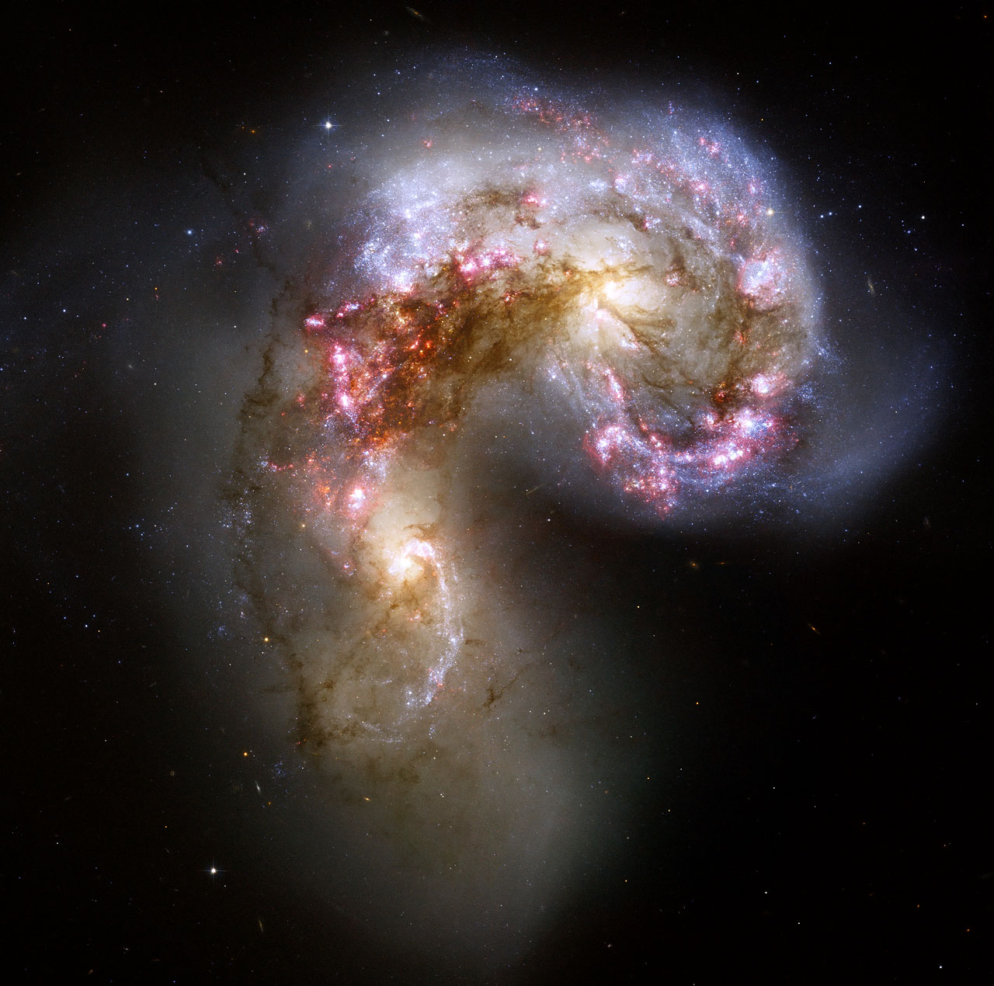
Galaxies
Irregular Galaxy
One that does not have a regular shape such as spiral arms or an obvious central bulge.
These galaxies are a mixture of old and new stars.

Slide 18
https://www.youtube.com/watch?v=bENTuGmw0Sg

Slide 20
The Birth of a Star
Star
An object in space made up of hot gases with a core that acts as a thermonuclear reactor.
“There are more stars in the universe than grains of sand on all the beaches of Earth.”
-Carl Sagan, American Astronomer

Slide 21
The Birth of a Star, cont’d
A star begins to form from the materials in a nebula when gravity starts acting on the chunks of dust and gas, pulling them together.
As this continues, the mass grows, and materials collapse in on itself and contracts; this results in a protostar.

Slide 22
The Birth of a Star, cont’d
At this stage, the star may stay small or shrink away.
OR
If it collects enough mass of dust and gas, the protostar’s core will eventually reach 10 million ºC; at this temperature, hydrogen atoms start to fuse together to make bigger helium atoms.

Slide 23
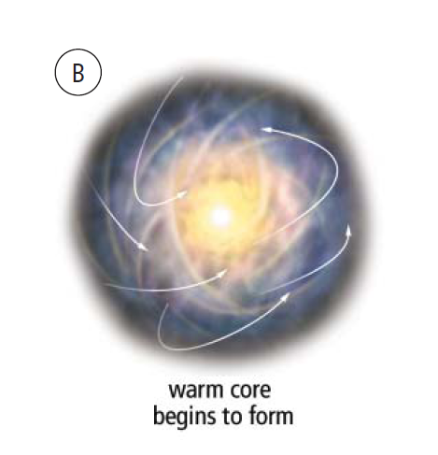
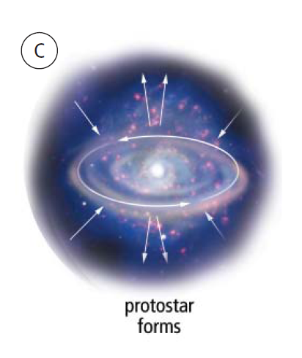
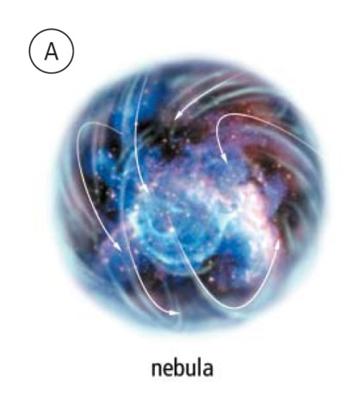
The Birth of a Star, cont’d
When this occurs, the star begins to glow producing energy in the form of electromagnetic waves.
This is how the Sun heats us.

Slide 24
Evolution of a Star
Low Mass Star:
Small; exist that way for most of life
Cool, dim, red dwarfs
Burn hydrogen fuel slowly so they may last for up to 100 billion years
Eventually change into very hot, small, dim white dwarfs and quietly burn out.

Slide 25
Evolution of a Star
Intermediate Mass Stars
Similar mass to the sun
Burn hydrogen fuel much faster; last about 10 billion years.
After a long period of stability, these stars expand into red giants.
Gradually sheds much of its material into space and collapses in on itself, slowly shrinking into a small, dim white dwarf.

Slide 26
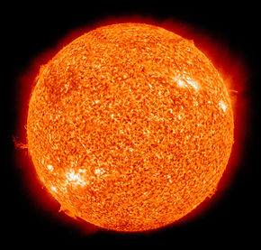
Evolution of a Star
Intermediate Mass Stars, cont’d
As it cools even more, it turns into a black dwarf: a dense, dark body made up mostly of carbon and oxygen.
Our sun will expand to a
red giant in about
5 billion years.

Slide 27
Evolution of a Star
High Mass Stars
12 or more times the mass of the sun
Consume fuel faster and become red giants
Last only 7 billion years – very short for a star
Have a violent end:
Massive stars that have used all their fuel become supergiants; they collapse in on themselves causing a dramatic explosion called a supernova.

Slide 28
Evolution of a Star
High Mass Stars, cont’d
Supernovas play an extremely important role in the universe. When the explosions occurs, heavy elements are dispersed including oxygen, carbon, etc.
The carbon that makes up your bones, the oxygen you breathe, and the water you drink all resulted from the death of a star.

Slide 29
Evolution of a Star
High Mass Stars, cont’d
If the star began with a mass about 12-15times that of the sun, the supernova collapses in onto itself creating a neutron star. The neutron star starts out being 1 million kms in diameter but then collapses to be only 10 km.
Neutron stars can get up to 100 000 000ºC and take trillions of years to cool

Slide 30
Evolution of a Star
Black Holes
If a star starts at 25 or more times larger than the sun, it does not become a neutron star, it becomes a black hole instead.
Because black holes are so dense, they have an extraordinary gravitational pull.
They are black because they are so dense and light cannot escape the gravitational pull.

Slide 31
Evolution of a Star
Black Holes
If we can’t see them, how do we know they exist?
They emit electromagnetic radiation.
Their gravity effect nearby celestial bodies.
Computer models have shown how super-dense objects will distort light from distant stars. These simulations match observations from astronomers.

Slide 32
Evolution of a Star
Quasars
An area around a supermassive black hole that has powerful electromagnetic energy.
Get their energy from the gravitational energy of matter falling into the black hole
Brightest objects that we know of.
Very far away from Earth; light that we see from Quasars is very old.

Slide 33
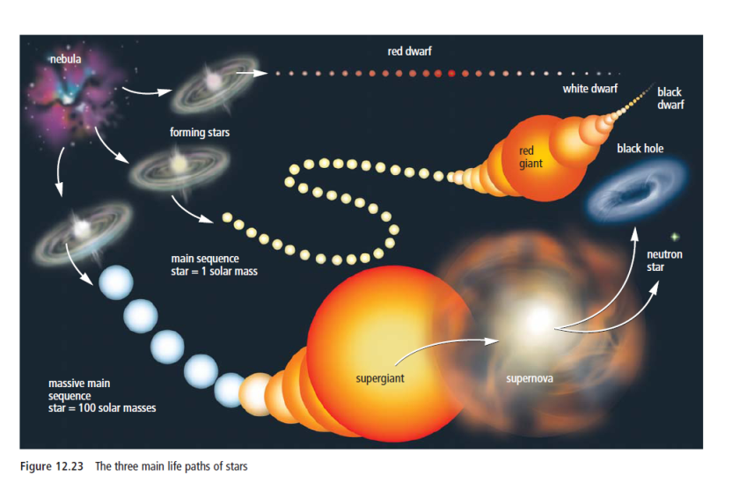
Evolution of Stars

Slide 34
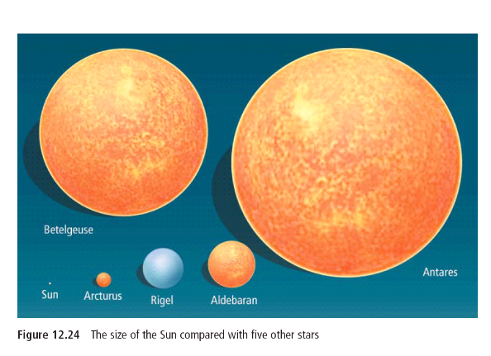
Star Sizes
Many stars visible from Earth are much larger than our sun.

Slide 35
12.3 Our Future in Space

Slide 36
Rewards of Space Exploration
Satisfies our curiosity
Space technologies also have purposes for life on Earth. Ex. Freeze-dried foods, specialized clothing, etc.
Loss of bone density in space has lead to treatments of osteoporosis.

Slide 37
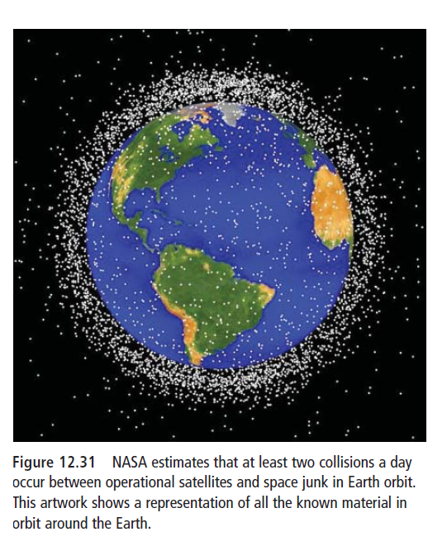
Risks of Space Travel
Equipment failure
Space debris
Astronauts are exposed
to radiations.

Slide 39
Space Exploration videos
https://www.youtube.com/watch?v=Zsf4NXcE4Qg
https://www.youtube.com/watch?v=7PKsu4kIBEA
https://www.youtube.com/watch?v=DlkjMnWNjic
https://www.youtube.com/watch?v=jRn4WpoNAyo

