Slide 1
Chapter 8
Ohm’s law describes the relationship of
current, voltage, and resistance.

Slide 2
Electric Potential Energy
Energy – the ability to do work.
Potential Energy – the energy stored in an object.
This kind of energy may be found in a battery or in other places like a stretched rubber band or a rock on top of a hill. Both objects have the potential to be put into motion.

Slide 3
Electric Potential Energy, cont’d
Electric Potential Energy- the potential energy stored in batteries.
In general, the bigger the battery, the more electric potential energy it has stored inside of it. A bigger battery will last longer than a smaller one because it has more space to store the energy.

Slide 4
Electric Potential Energy, cont’d
So where does the electric potential energy come from?
Answer: Charge/number of electrons. The electrons are in the battery and they ‘want’ to come out.

Slide 5
Electric Potential Difference
Voltage – the amount of ‘electric potential energy’ (stored energy) in one coulomb of charge.
Voltage is also known as “electric potential difference.” Think of it as the difference in charge between the inside of a battery and the outside (which is neutral).

Slide 6
Electric Potential Difference, cont’d
Important Note:
The closer electrons are together, the more energy they will have. Think of like poles of two magnets coming together and how the force gets larger the closer they get.
The same is true for electrons. If you jam more and more electrons into a battery, they will all want to repel. This creates the force or “potential difference” inside the battery.

Slide 7
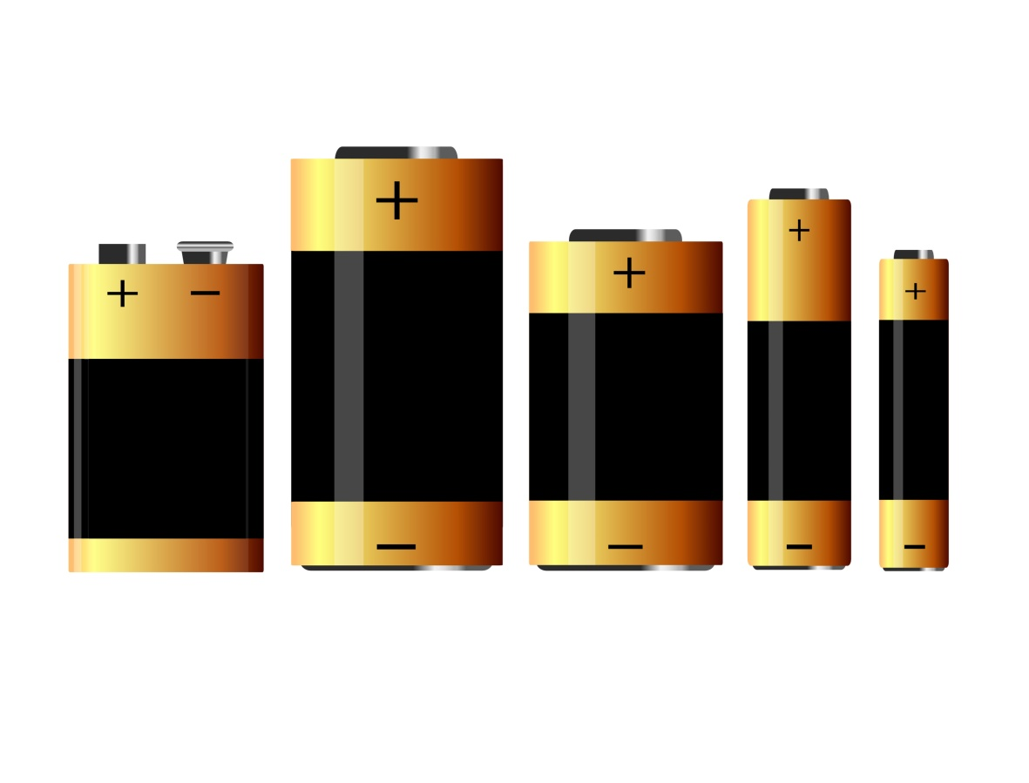
Electric Potential Difference, cont’d
In all of the 1.5V batteries, there is an equal amount of space between the electrons.
The electrons in a 9V battery are closer together than in the 1.5V batteries. Meaning they have a greater potential difference.

Slide 8
Electric Potential Difference, cont’d
The total amount of energy stored in a battery is dependent upon two factors:
1) The total number of electrons (charge) inside the battery,
2) The distance between the electrons inside the battery (the closer together, the higher the voltage).
Keep in mind that the size of the battery does NOT determine the voltage. A bigger battery will last longer but a higher voltage will give it more force.

Slide 9
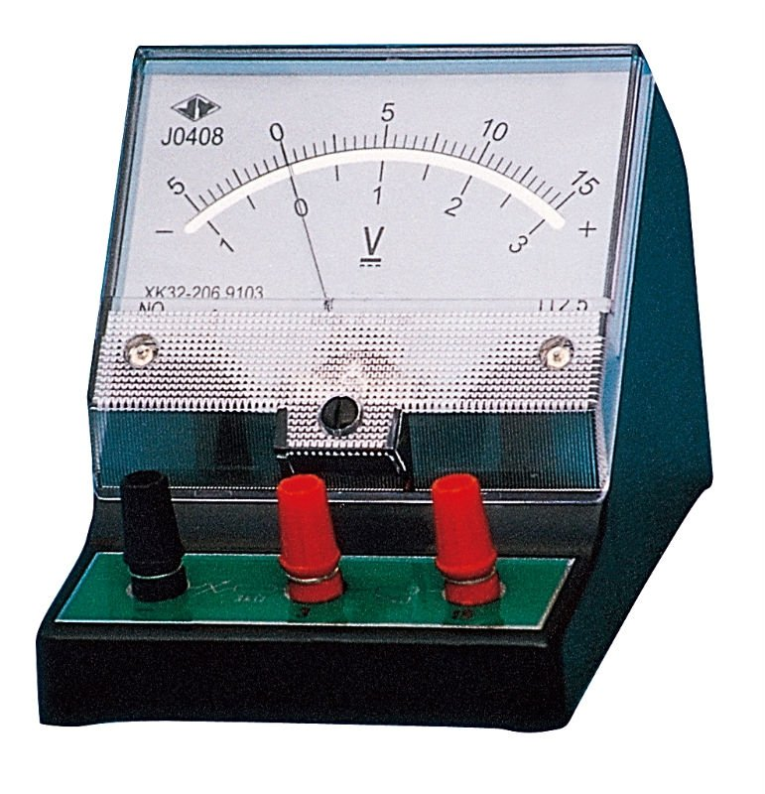
Electric Potential Difference, cont’d
Voltmeter: is a device that measures the amount of potential difference (voltage) between two locations of charge separation. For example, inside the battery and outside the battery.

Slide 10
Producing Voltage
Electrochemical cell – a device used to convert chemical energy into electrical energy stored in charges; chemical energy separates the positive and negative charges.
Battery – a series of electrochemical cells connected together.
In everyday life (and in the previous slides), we incorrectly use the word battery for an electrochemical cell. Let’s put an end to the madness!

Slide 11
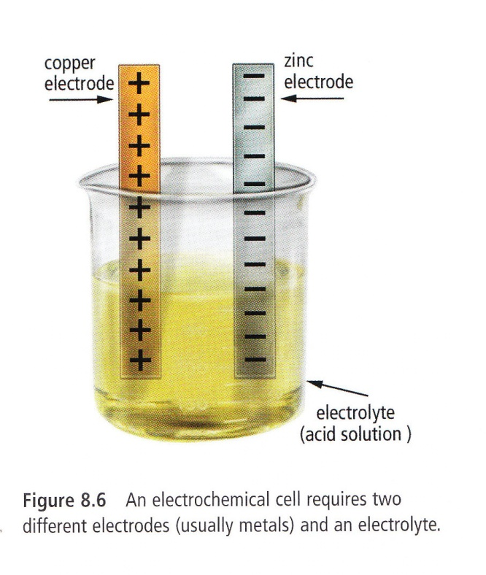
Electrochemical cell
A battery has two terminals called electrodes, one is negative, the other positive.
The electrodes are placed
in an electrolyte:
a substance (liquid or
paste) that conducts
electricity.

Slide 12
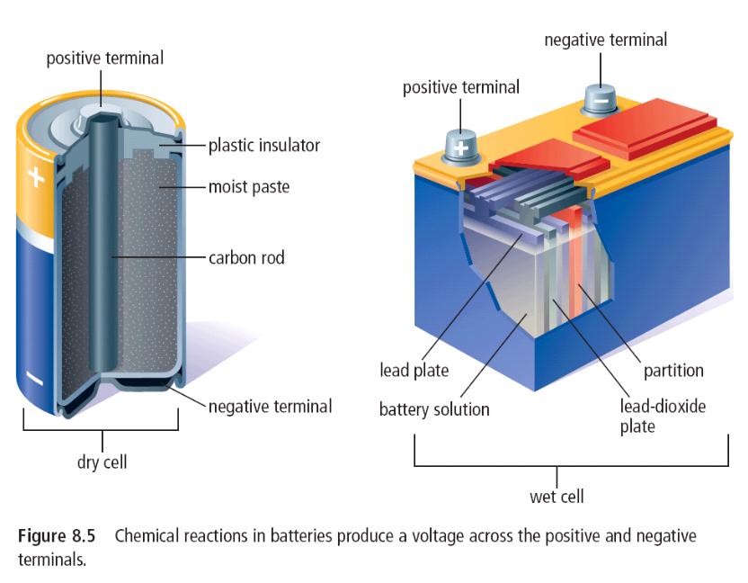
Figure 8.5

Slide 13
8.2: Electric Circuits
Electric circuit – a complete pathway that allows electrons to flow.
It has four main parts:
Source of electrical energy (ex. A battery).
And electrical load (something to use the energy).
A switch to turn the circuit on and off.
A conductor that allows the electricity to flow through (ex. wires).

Slide 14
Electric circuits, cont’d
Electric current – the flow of electricity through a conductor; think of it as being similar to the flow of cars on a busy highway or the flow of water in a river.
Ampere (A) – the unit of measurement of electric current. Also called amps.

Slide 15
Electric circuits, cont’d
It is important to remember that electric potential is provided by the source and “used” by the circuit elements. There is only so much voltage to go around so this causes a voltage drop.
Voltage drop – the loss of voltage across loads in a circuit.

Slide 16
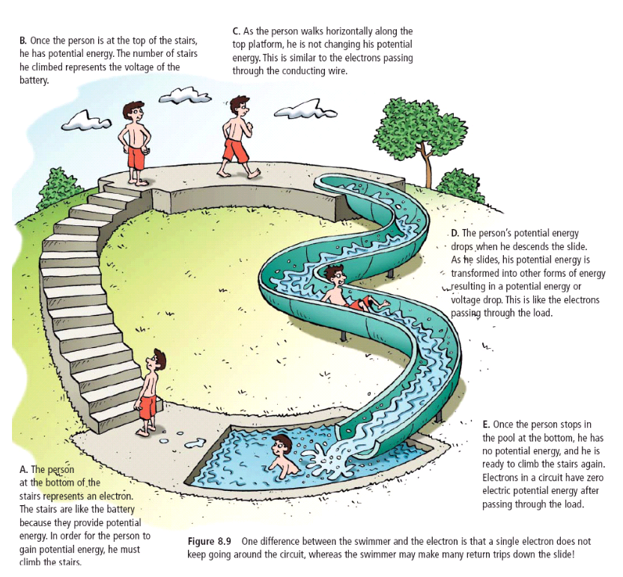
Energy around a circuit

Slide 17
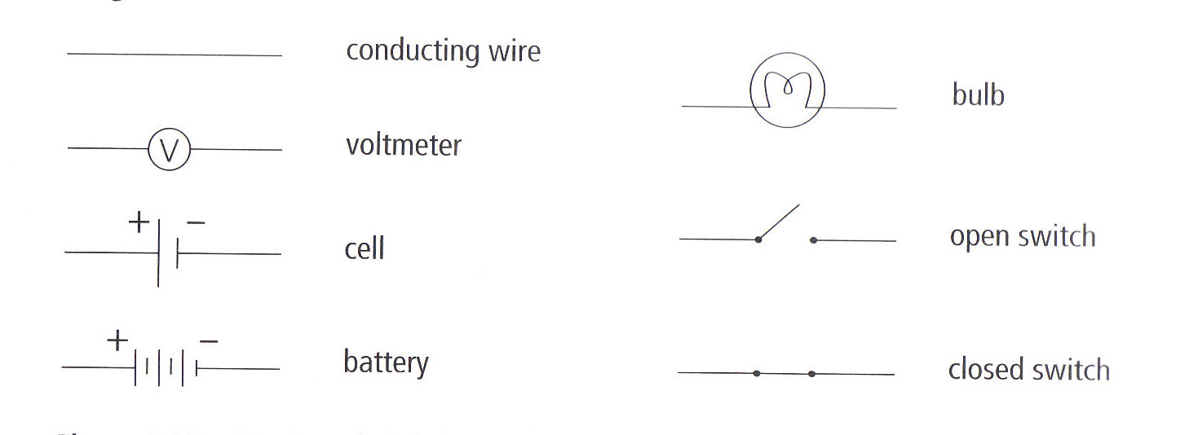
Electric Circuit diagrams
Electric circuits can be represented symbolically:
ammeter
ammeter
ammeter
resistor

Slide 18
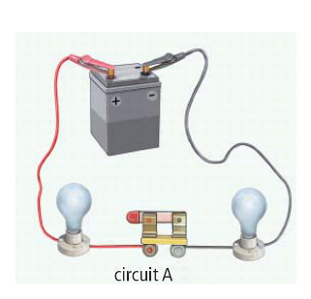
Let’s draw some circuit diagrams!
Activity 8-2B page 263

Slide 19
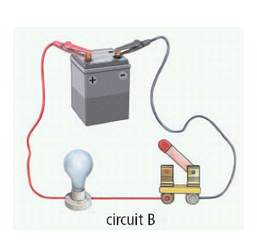

Slide 20
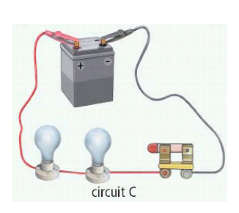

Slide 21
Electrical Energy Sources
Friction
Rubbing two materials together separates charge (one becomes negative, the other becomes positive). The work done by rubbing is converted into the electrical energy stored in the separated charge.

Slide 22
Electrical Energy Sources, cont’d
Piezoelectric crystals
‘piezo’ = push
When certain types of crystals are pushed or squeezed, positive and negative charges separate on either side of the crystal.
In a barbeque lighter, quartz is squeezed. Then a small hammer hits the crystal, generating a burst of thousands of volts of electricity.

Slide 23
Electrical Energy Sources, cont’d
Photoelectrical cells
Used in solar panels and many calculators
Made of silicon which is a semi-conductor.
When light hits the cell, some of the light breaks electrons off the surface. This separation of electrons causes electrical energy.

Slide 24
Electrical Energy Sources, cont’d
Thermocouples
Transforms electrical into heat energy.
Consists of a loops of two wire of different metals joined at both ends. If one end of the loop is heated or cooled, charge is separated and a voltage is created across the thermocouple.

Slide 25
Electrical Energy Source, cont’d
Generators
They work on the principle that when a wire moves close to a magnet or a magnet moves close to a wire, a voltage is created across the wire.
All you need is an energy source to move the wire or the magnet.
In NL, we use hydroelectric energy – the movement of water creates electric energy.

Slide 26
8.3: Resistance
Electrical resistance – A property of any material that slows down the flow of electrons and converts electrical energy into other forms of energy.
Ex: In high resistance wire in light bulbs (aka the filament), the energy is converted to heat and light
Resistor – a device that is used to control the flow of electricity. By adding a resistor to a circuit, the current decreases.
Ohm (Ω) – the unit for measuring resistance.

Slide 27
Resistance, cont’d.
4 main factors that affect the resistance of a wire:
Length
the longer the wire, the greater the resistance
Diameter
A thin wire has more resistance than a thick wire.
Type
Different materials have different resistances
Temperature
A hot wire has more resistance than a cold wire.

Slide 28
Ohm’s Law
Resistance, current and voltage are related in such a way so that:
V = I x R
R = V ÷ I
I = V ÷ R
R – Resistance (ohms - Ω)
V – Voltage (volts - V)
I – Current (amperes – A)

Slide 29
Ohm’s Law, cont’d
This information can be organized into a triangle:
V
I
R

Slide 30
Ohm’s Law, cont’d
Let’s practice some problems:
1. The current through a load is in a circuit is 5.0 A. If the potential difference across the load is 75 V, what is the resistance of the load?

Slide 31
Ohm’s Law, cont’d
2. The resistance of a load in a circuit is 10Ω. If the current is 1.2 A, what is the voltage across the load?

Slide 32
Ohm’s Law, cont’d
3. A 120 V potential difference is measured across a load that has a resistance of 30Ω. What current is moving through this load?

Slide 33
Ohm’s Law, cont’d
Converting Prefixes: Prefixes are used to indicate the magnitude of a value.
milli (m) represents one-thousandth (EX. 25 mA = 0.025 A)
kilo (k) represents on thousand (EX. 5 kΩ = 5000 Ω)
Mega (M) represents one million (EX 12 MV = 12 000 000 V)
When solving a problem when some of the units contain prefixes, first convert the prefixes before you do you calculation)
Example: What is the voltage across a 12 k Ω load that allows a current of 6 mA?
Answer: V = IR
= (6 mA)(12 k Ω)
= (0.006 A)(12 000 Ω)
= 72 V

Slide 34
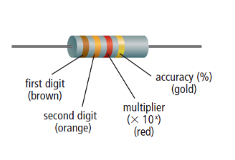
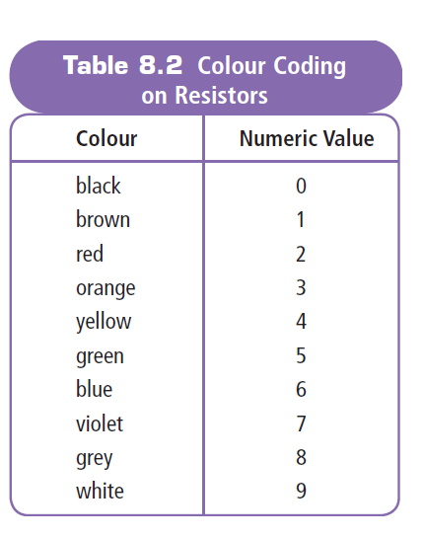
Resistor Colour Codes
Resistors are marked with coloured bands which indicated the resistance.
First band- first digit
Second band – second digit
Third band – multiplier (x10^{x}).
Fourth band – accuracy (%)

Slide 35
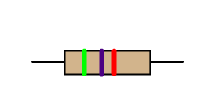
Resistor Colour Codes, cont’d
Ex. Calculate the resistance of the following resistors:
A)

Slide 36
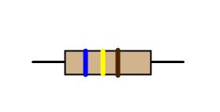
Resistor Colour Codes, cont’d
B)

Slide 37
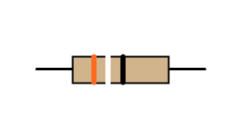
Resistor Colour Codes, cont’d
C)

Slide 38
Demonstration
http://www.article19.com/shockwave/oz.htm

Slide 39
Core Lab
Resistors and Ohm’s Law
8-3D Resistors and Ohm’s Law

Slide 40
Practice Questions
Page 282
#’s 1 - 4, 6, 7, 8, 9, 10 – 19, 24, 27 -- 33.

