Slide 1
Chapter 7
Static charge is produced by electron transfer

Slide 2
ELECTRICITY is everywhere!

Slide 3
Electricity
There are two types:
Static Electricity: The build-up of electric charges on the surface of objects.
A static charge does not move unless it is removed by a ground or is discharged.
Getting shocked is a result of static electricity.
Current Electricity: The continuous flow of electric charge (through a wire, for example).

Slide 4
Small Review from Unit 1
All matter is made up of small particles called atoms.
The center or nucleus of an atom contains neutrons (no charge) and protons (positive charge).
The nucleus has a positive charge.
Electrons (negative charge) are around the positive nucleus.
Electrons are smaller and can sometimes move between energy levels.
Protons are larger and are found in the nucleus. They do not move.

Slide 5
Charges on objects can change
In a solid material, only the electrons are able to move. The protons do not move; they remain inside the nucleus.
Solid materials become charged as electrons are transferred between materials.
The friction between two objects can result in one object losing electrons and the other object gaining electrons.

Slide 6
Charges on objects can change
Positive charge: if an object loses electrons (negative) it has more positive charge than negative so the object has an overall positive charge.
Negative charge: if an object gains electrons (negative) it has more negative charge than positive so the object has an overall negative charge.
Neutral: if an object has the same number of positive charges and negative charges.

Slide 7
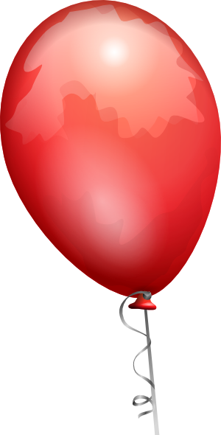
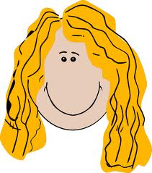
Charges on objects can change
Did you ever rub a balloon on your head and stick it to a wall? Did you notice your hair was attracted to the balloon afterwards? This is due to electron transfer.
Both objects are neutral but when rubbed together, the electrons move from
the surface of your
hair onto the balloon.
Results:
hair:+charge
balloon:-charge
e-

Slide 8
Friction and Static Charge
Friction occurs when objects rub against each other. The friction between two objects can result in one object losing electrons and the other object gaining electrons.
Acetate is a type of plastic used in photographic film and overhead transparencies. If the acetate strip is rubbed with a paper towel, electrons move from the paper towel onto the acetate strip.

Slide 9
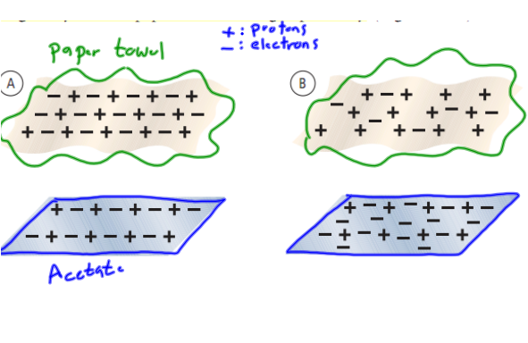
Friction and Static Charge
The acetate strip will now have more electrons so its charge is now negative. The paper towel has less electrons so its charge is now positive.

Slide 10
Conductors/insulators
Insulator
Any material that does not allow charges to move easily.
Ex. Glass, ceramic, and wood are all good insulators.
Conductor
Any material that does allow charges to travel freely.
Ex. Metals are good conductors.
Only insulators can hold a static charge because conductors allow charges to flow.

Slide 11
Removal of Static Charge
Charged objects, either negative or positive, become neutral by attaching or touching a conductor to it.
The conductor transfers any excess static charge to the conductor (evenly spread over the conductor)
Grounding: connecting a conductor so that electric charge flows into Earth’s surface.
Electric Discharge: the removal of an electric charge from an object. Ex: Lightning, rubbing feet across carpet then touching a doorknob.

Slide 12
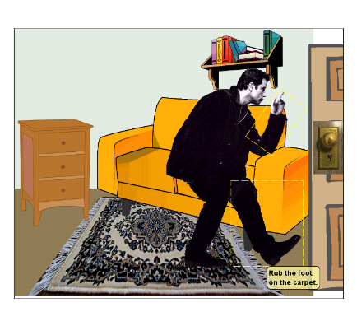
John Travoltage
http://phet.colorado.edu/en/simulation/travoltage

Slide 13
Measuring Charge
Coulomb: the unit of electric charge. 1 coulomb of charge equals the addition or removal of 6.25 X 10¹⁸ electrons.
This is about the number of electrons that pass through a 100 W light bulb per second.

Slide 14
Measuring Charge
Force is defined as a push or pull
1. Contact Force: the movement between two objects through physical contact.
2. Electric force is an example of an “action at a distance force”; this just means that the force can be applied to an object without touching it.
EX: Electric force: is a push or pull between charged objects

Slide 15
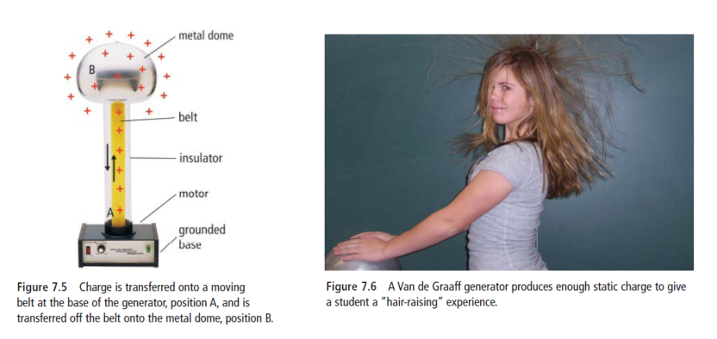
Generating Static Charge
Van de Graff generator
Uses friction to produce a large static charge on a metal dome. A moving belt produces a static charge at the base of the generator. It then carries this charge to the top where it collects on the dome.

Slide 16
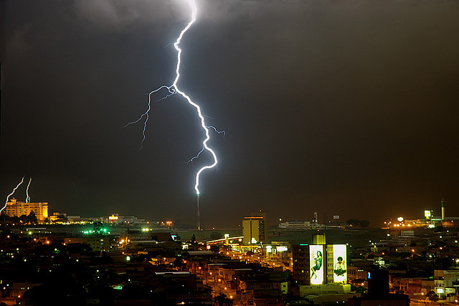
Technologies that developed from static electricity
1. Lightening Rod
A metal rod placed on top of buildings in areas where there is a high incidence of lightening. This rod attracts the lightening and is attached to a wire that runs to the ground.

Slide 17
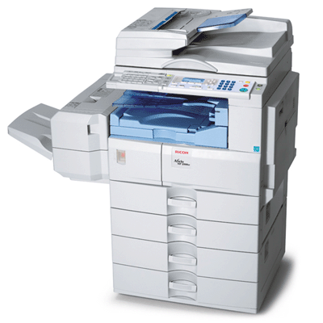
Technologies that developed from static electricity, cont’d
2. Photocopiers
Described on page 241 in text.

Slide 18
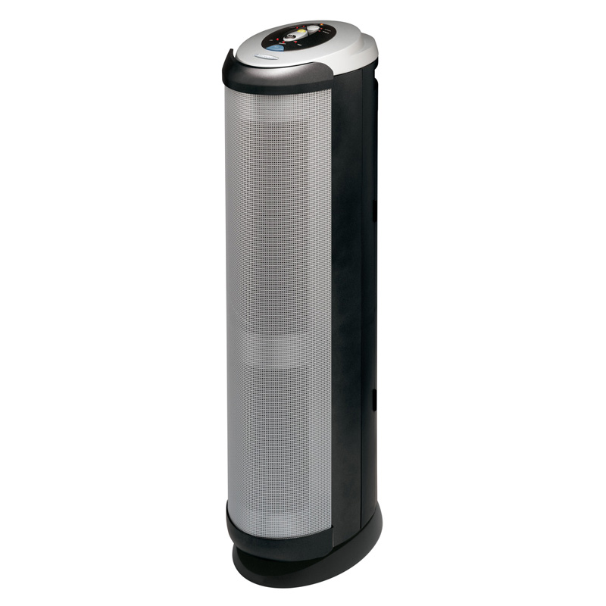
Technologies that developed from static electricity, cont’d
3. Electrostatic Cleaners (aka air purifiers)
Uses current electricity to charge plates inside the mechanism. Air is forced into the machine. The negatively charged plates are attracted to dust and other microorganisms in the air. These impurities stick to the plates and clean air exits the machine.

Slide 19
Technologies that developed from static electricity, cont’d
4. Other:
Plastic sandwich wrap clings because of static charge.
Static electricity is used to decrease air polution. Devices in chimneys use static charge to remove small particles of smoke and dust.
Static electricity is useful in painting automobiles. The paint is given an electrical charge and then sprayed onto the automobile. The charged paint particles stick to the metal.

Slide 20
Careers related to Static Electricity
Photocopier technician
Electrician
Engineer
Etc.

Slide 21
Section 7.1 Questions
Page 237
# 2, 4 – 9, 11, 13 - 16

Slide 22
Section 7.2 Electric Force (Cont)
Early scientists discovered that two positively charged objects placed together repelled each other as did two negatively charged objects.
When a positively charged object was brought close to a negatively charged object, the two objects attracted one another.
Charged objects also attract neutral ones.

Slide 23
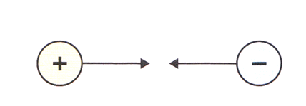
Laws of Electric Charges
Like Charges Repel
Unlike Charges Attract
Charged objects will attract some neutral ones.

